Slide 1
Case Study: Firearm Education Project
Haley Bustle
February 2024

Slide 2
Project Tools & Resources
Project Duration: Two Weeks
Project Resources
CDC Wonder – website containing all death reports in the U.S. for a specific time frame. Allows you to create a custom dataset based on certain factors (in this case, deaths by state, gender, cause of death type, and age group)
US Census Bureau – website containing estimated population counts by state, year, county, gender, and age group
Tools Utilized
Microsoft Office: Word and Excel for project summary, data description, and final project report with final dataset
Python & Jupyter: data analysis and wrangling

Slide 3
Project References and Data Sources
Dataset 1: US Census Bureau population estimates, 2009 to 2017
Dataset 2: CDC Wonder custom dataset, death by firearms 2009 to 2017
Please note, this dataset has been edited prior to my usage for this study. These changes are available for viewing on Github in the Project Folder, file 02 Data, File Data Collection. The original unaltered dataset is also viewable
Final Report available on GitHub
Final Tableau Storyboard
Tableau Visualizations
Not all visualizations created were used in the final project

Slide 4
What is the Firearm Education Project?
Final project for Career Foundry’s Data Analysis certificate program
Project chosen due to personal background in the subject as well as a desire to learn more information & provide an unbiased report
Aim of project is to identify the leading cause of death by firearms amidst common misconceptions and misinformation
One challenge is often the misconception about firearms due to the portrayal of firearms and related legislation in media and news outlets
Objective of project is to foster better understanding proper explanation of situations (mass shootings, police encounters such as of firearms to contribute to public education materials and foster discussions of community safety
Knowledge, grounded by unbiased data, allows communities to navigate the complexities of firearms, ownership, and responsibility that can in turn have a positive impact on societal well-being and community safety

Slide 5
Project Challenges
Timeframe of project limited to 2009 to 2017 due to project requirements
Project required time element; Census Bureau does not have most recent census estimate available as a dataset for download. Used existing census estimates dataset from separate project
Data Limitations
Data shows a skew toward male statistics, large potential of underreporting of incidents, and categorization of deaths (there was found to be unreliable reports of deaths by accidental discharge)
Data for firearm deaths was collected by the CDC Wonder website, which states any report equal or under nine is considered “unreliable” and marked as a zero. This can cause a misrepresentation in data, since the true nature of the zeros cannot be determined
CDC Wonder does not also classify the deaths beyond the homicide, suicide, and accidental discharge. There is no way to confirm if the stats consider suicide by cop, mass shootings, gang violence; if data was suppressed due to privacy, national security risk, age of victim(s), or misreported cause of death

Slide 6
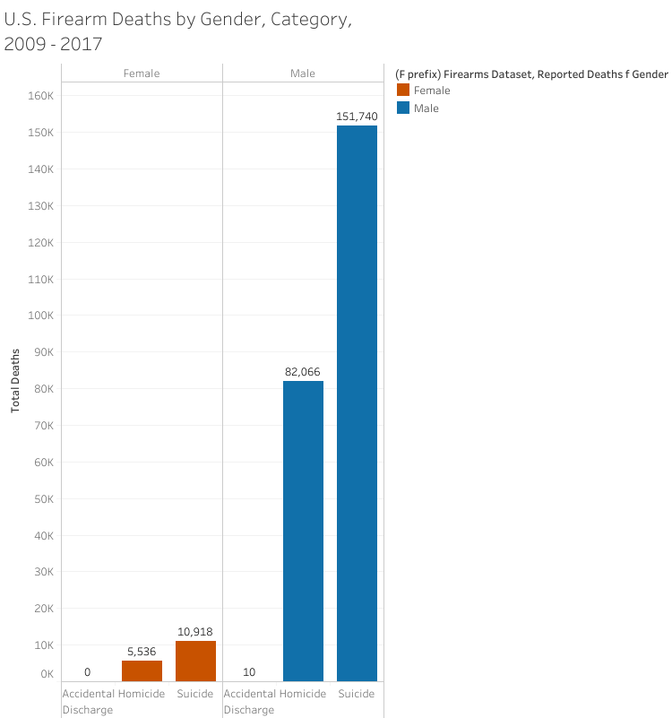
Project Insights: Suicide and Gender Disparities
Suicide by firearm was the highest reported cause of death, males are higher than females
Higher male death reports than females, cannot confirm by CDC if that is due to true zero deaths or unreliable reports (marked as 0 deaths)
One report of deaths by accidental discharge, excluded from study
High rates of suicide by firearm poses questions that could not be answered scientifically in this project – another challenge to completing this analysis
Suggests moral questions like mental health resources, background checks of firearms, firearm availability, socioeconomic status, etc.
This data was documented in the final report but not explained in depth due to potential of bias and lack of credible resources to back up this data

Slide 7
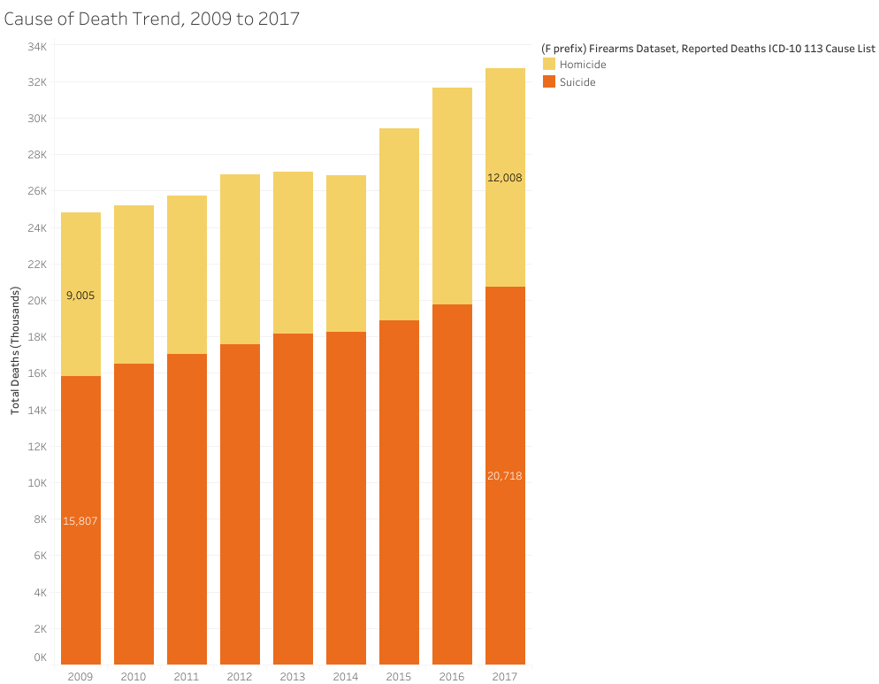
Project Insights: Socioeconomic Considerations
Rates of deaths by firearms have increased from 2009 to 2017, suggesting a positive relationship in population growth and firearm deaths
Suicide reports per year are higher than homicide reports
Data poses a few challenges:
Since there are less female reports than men, are these results accurate?
Do these reports include all manners of death by firearm? As mentioned, military suicide and/homicide, gang violence, mass shootings, suicide by cop, etc
Are the rates of deaths truly increasing, or are the resources to report such incidents become more available/easily accessed?

Slide 8
Project Conclusions and Remarks
Project Challenges
Encountered limitations in final presentation of findings due to sensitive nature of subject and the importance of remaining unbiased
Faced a scarcity of reliable resources to provide a more comprehensive analysis and recommendations for next steps in project conclusion
Analysis Challenges
Numerous zeros within the dataset, particularly with deaths related to accidental discharge
Data skewed with more male deaths than female, indicating alarming trends that require urgent follow up analysis
Analysis Development
Identified crucial need for research into underreported female suicide & high report of male suicide deaths; suggests a potential of mental health crisis
Recognized the significance in continued research in firearm deaths and the importance of proper education materials to create responsible firearm owners.
Lack of available resources suggests a more detailed data-driven study to illuminate underexplored aspects of firearm-related deaths

Slide 9
Thank you

